Slide 1
How to create features to do Machine Learning with Gene Sequences?
Ved Piyush

Slide 2
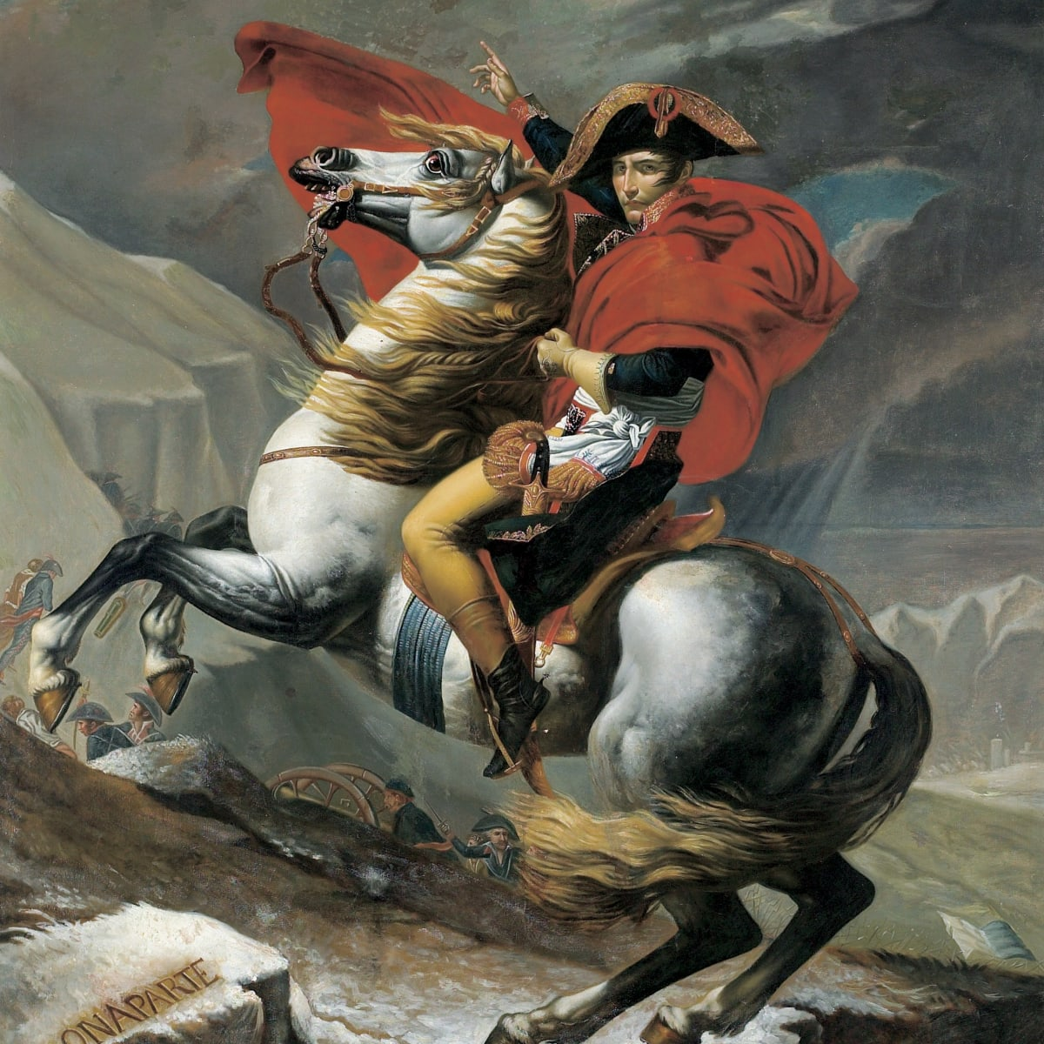

Motivation
He who has the best artillery wins the war.
He who has the best features wins the Machine Learning war.

Slide 3
Agenda
Bag of Words
Embedding Methods
Recurrent Neural Networks

Slide 4
Bag of Words – (BOW)
Suppose there are two Gene sequences
GH30, AA9, GH67, GH19 and GH33, AA10, GH30, GH25
Collect all unique genes – (GH30, AA9, GH67, GH19, GH33, AA10, GH25) - vocabulary
First Gene Encoded as – (1, 1, 1, 1, 0, 0, 0)
Second Gene Encoded as – (1, 0, 0, 0, 1, 1, 1)

Slide 5
Variations – Binary vs Counts
Consider another two gene sequences
GH30, GH30, GH30, AA10, AA19, AA19
GH32, GH45, GH45, CBM9, CBM9, AA15
Vocabulary – GH30, AA10, AA19, GH32, GH45, CBM9, AA15
Binary BOW for first sequence – 1, 1, 1, 0, 0, 0, 0
Counts BOW for first sequence – 3, 1, 2, 0, 0, 0, 0

Slide 6
Embedding Methods
Word2Vec (think as Gene2Vec)
Doc2Vec (think as GeneSequence2Vec)

Slide 7
Word2Vec Skip Gram
Consider two gene sequences:
GH67, AA10, GH75, CBM9, GH32, AA10 and GH68, AA11, GH76, CBM10, GH33
Consider a window size – for example 2
Go gene by gene (for first sequence)
First Gene – GH67:
Positive Genes – Null, Null, AA10, GH75

Slide 8
Word2Vec Skip Gram Training Data
GH67 – Null
GH67 – Null
GH67 – AA10
GH67 – GH75
We do this data generation for all gene sequences.
This is the input data used to train the Word2Vec model

Slide 9
Word2Vec– Skip Gram
First Gene – GH67
Input will be it’s one hot encoded representation
For example, it could be – (0, 0, 0, 1, 0, 0, 0, 0) (depends on the vocabulary)
Output – One Hot Encoded representation of Null, Null, GH75 and AA10
Is basically a multiclass classification problem.

Slide 10
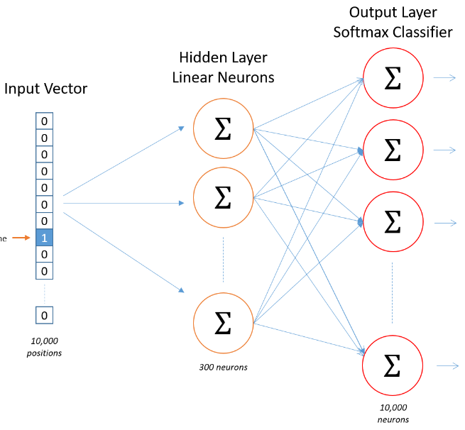
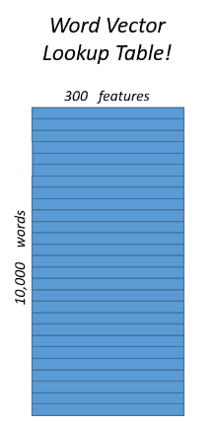

Word2Vec Skip – Gram Architecture
Assume – 10,000 unique genes

Slide 11
Word2Vec Continuous Bag of Words (CBOW)
Consider two gene sequences:
GH67, AA10, GH75, CBM9, GH32, AA10 and GH68, AA11, GH76, CBM10, GH33
Consider a window size – for example, 2
Go gene by gene (for the first sequence)
First Gene – GH67:
Preceding Genes – Null, Null
Succeeding Genes – AA10, GH75

Slide 12
Word2Vec CBOW Training Data
Null – GH67
Null – GH67
AA10 – GH67
GH75 – GH67
We do this data generation for all gene sequences.
This is the input data used to train the Word2Vec model

Slide 13
Word2Vec– CBOW
Target Gene – GH67
Output will be it’s one hot encoded representation
For example, it could be – (0, 0, 0, 1, 0, 0, 0, 0) (depends on the vocabulary)
Input – One Hot Encoded representation of Null, Null, AA10, GH75
We take the One Hot Encoded representations of the above input genes.
We can either average or sum those one hot encoded vectors element-wise. (input)
The element-wise averaged or summed vector is the input.
Architecture is the same as the Skip-Gram model.

Slide 14
Word2Vec CBOW Architecture
This might not be 0 anymore
This might not be 1 anymore
Assume – 10,000 unique genes

Slide 15
Doc2Vec – (GeneSequence2Vec)
Gives the features directly for the entire gene sequence.
Therefore, is simpler than Word2Vec for feature creation.
Why is it simpler?
Word2Vec will give a feature for each gene.
We still need to do additional processing to create the feature for the gene sequence.
Either by element-wise averaging or element-wise sum.
Doc2Vec does not require this additional processing step.
Has two variants – Distributed Memory (DM) and Distributed Bag of Words (DBOW)

Slide 16
Doc2Vec (DM)
Consider two gene sequences:
GH67, AA10, GH75, CBM9, GH32, AA10 (1) and GH68, AA11, GH76, CBM10, GH33 (2)
Consider a window size – for example, 2
Go gene by gene (for the first sequence)
First Gene – GH67:
Preceding Genes – Null, Null
Succeeding Genes – AA10, GH75
We add another ID for the gene sequence – 1
Looks very similar to the Word2Vec CBOW model.

Slide 17
Doc2Vec (DM) Training Data
(Null, 1) – GH67
(Null,1) – GH67
(AA10,1) – GH67
(GH75,1) – GH67
We do this data generation for all gene sequences.
This is the input data used to train the Doc2Vec - DM model
Assume D unique gene sequences and V number of unique genes.

Slide 18
Doc2Vec– DM
Target Gene – GH67
Output will be it’s one hot encoded representation
For example, it could be – (0, 0, 0, 1, 0, 0, 0, 0) (depends on the vocabulary)
Input – One Hot Encoded representation of Null, Null, AA10, GH75
We take the One Hot Encoded representations of the above input genes.
We can either average or sum those one hot encoded vectors element-wise. (1 x V)
We also one hot encode the documents – (1 x D)
Input is a concatenated vector of dimensions – (1 x (V + D))

Slide 19

Doc2Vec DM Architecture
V
V
D
D
Assume (D + V) = 10,000

Slide 20
Doc2Vec - Distributed Bag of Words (DBOW)
Consider two gene sequences:
GH67, AA10, GH75, CBM9, GH32, AA10 (1) and GH68, AA11, GH76, CBM10, GH33 (2)
Go gene sequence by gene sequence (for the first sequence)
Randomly select some genes to predict – (GH67, CBM9, GH32)
We add a ID for the gene sequence – 1
Looks very similar to the Word2Vec SG model.

Slide 21
Doc2Vec (DBOW) Training Data
(1) – GH67
(1) – CBM9
(1) – GH32
We do this data generation for all gene sequences.
This is the input data used to train the Doc2Vec - DBOW model
Assume D unique gene sequences and V number of unique genes.

Slide 22
Doc2Vec– DBOW
Target Gene – GH67
Output will be it’s one hot encoded representation
For example, it could be – (0, 0, 0, 1, 0, 0, 0, 0) (depends on the vocabulary)
Input – One Hot Encoded representation of Gene Sequence 1. ( 1 x D)

Slide 23
Doc2Vec DBOW Architecture
D
D
Assume D = 10,000

